Slide 1
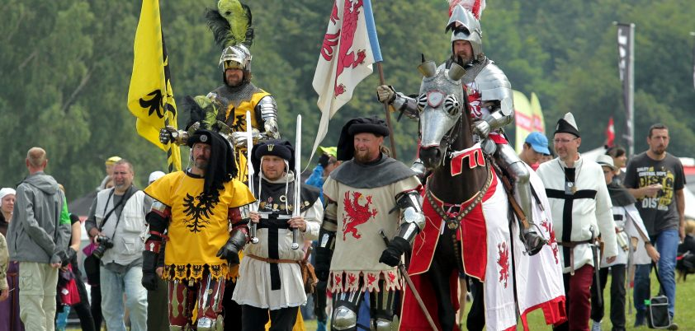
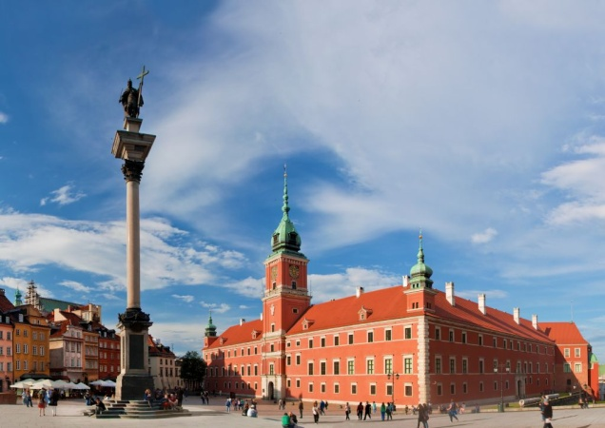
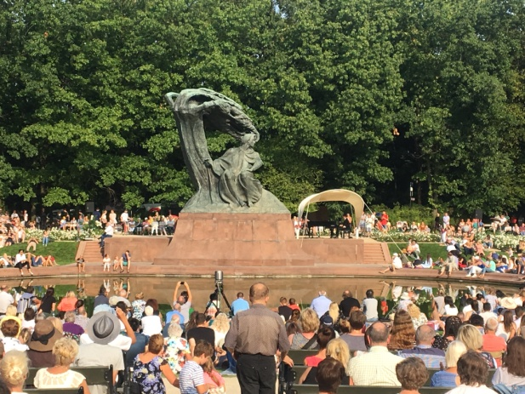
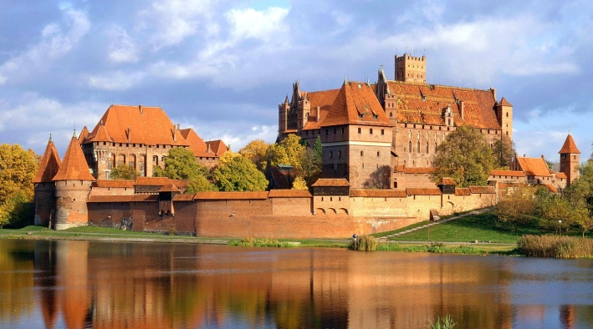
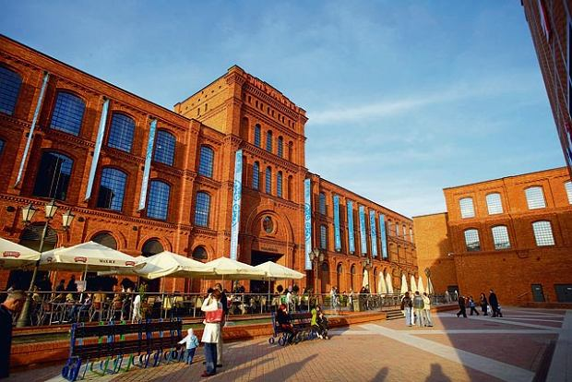
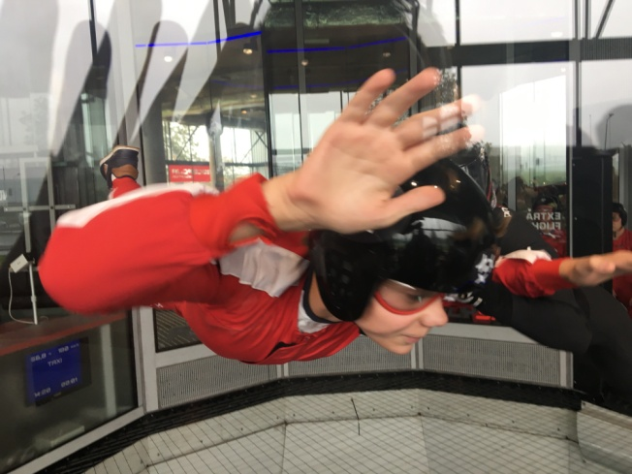
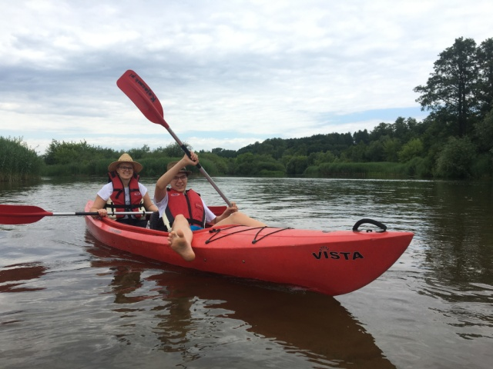
International Summer Camp “Poland – From Past to Present” Rotary Club Warsaw Fryderyk Chopin in cooperation with RC Łódź 4 Kultury District 2231 July 10 – July 23, 2019

Slide 2
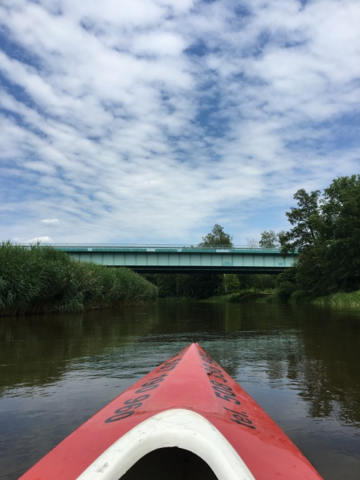
Host Country / Clubs : Poland
Rotary Club Warszawa Fryderyk Chopin
Rotary Club Łódź 4 Kultury
Theme of the camp : Learn about Polish history and Poland today
Program : See following pages
Participants : 8-12 ( 6 Girls & 6 Boys ) ( One Girl & Boy Per Country )
Age : 15–18
Language : English
Accommodation : Families & Hotel
Cost : 300 Eur
(Roundtrip Flight tickets, Insurance & Pocket Money Are Not Included)
Arrival : Warsaw Chopin Okęcie (WAW) and/or Warsaw Modlin Airports (WMI)
Departure : Warsaw Chopin Okęcie (WAW) and/or Warsaw Modlin Airports (WMI)
Insurance : Participants must be insured against illness,
accident and third party damages according to Rotary International
Requirements.
All Applications&Register (via e-mail) : (Before 01 May 2019) :
Mr. Michał Skup
Address: ul. Kwitnącej Łąki 2B, 02-971 Warszawa, Poland
Tel : +48 695 128 333
E-mail : m.skup@rotary.org.pl; michal.skup@eslimaki.pl

Slide 3
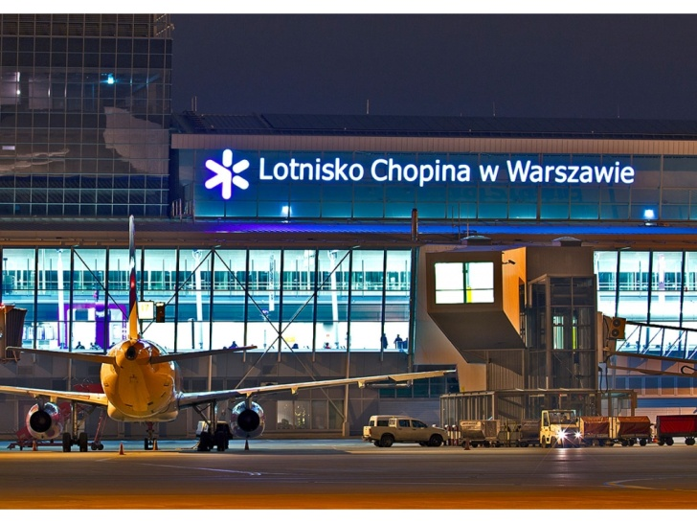
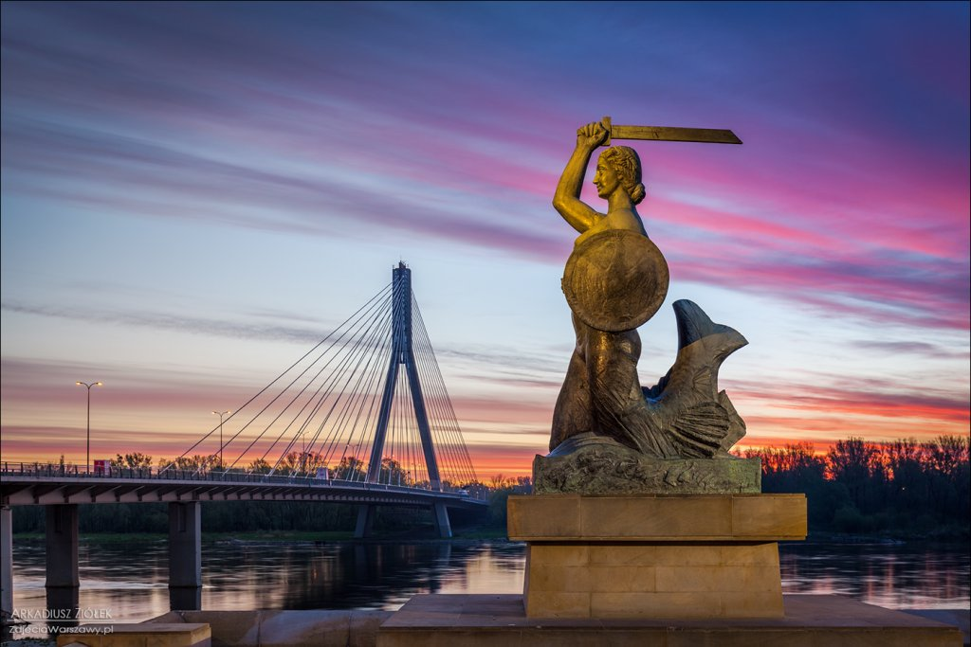
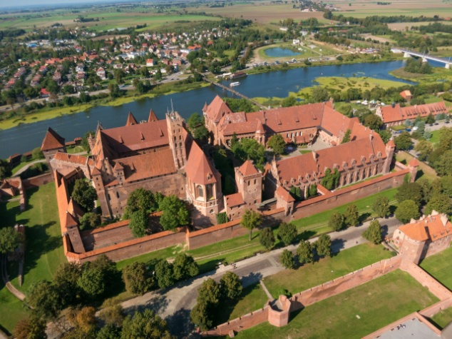
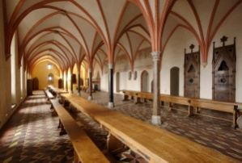
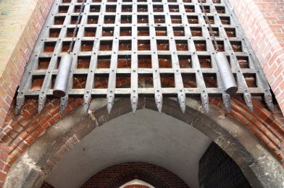
July 10 (Wednesday) : ARRIVAL
Meet with the Host Families at Airport and transfer home
July 11 (Thursday): Day with HOST FAMILIES
July 12 (Friday): Morning transfer to Malbork and guided tour of Europe’s largest medieval castle

Slide 4
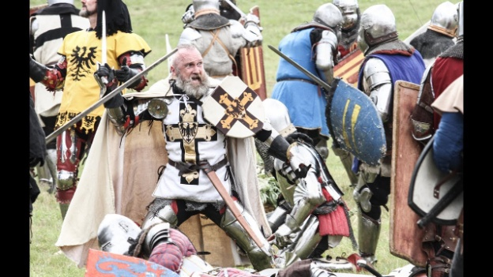
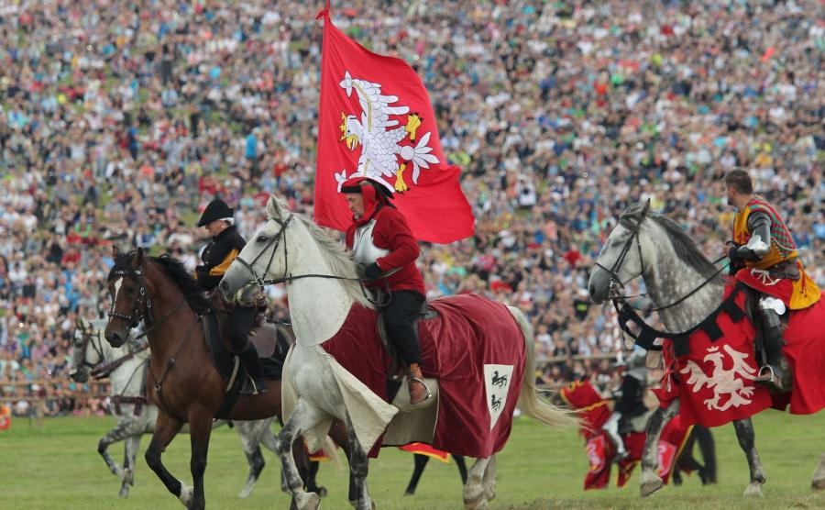
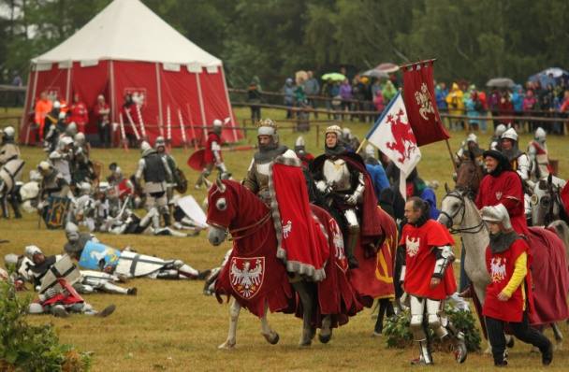
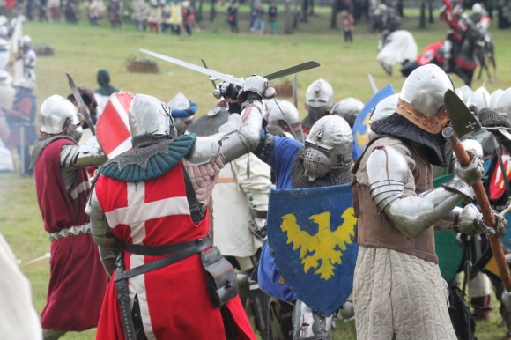
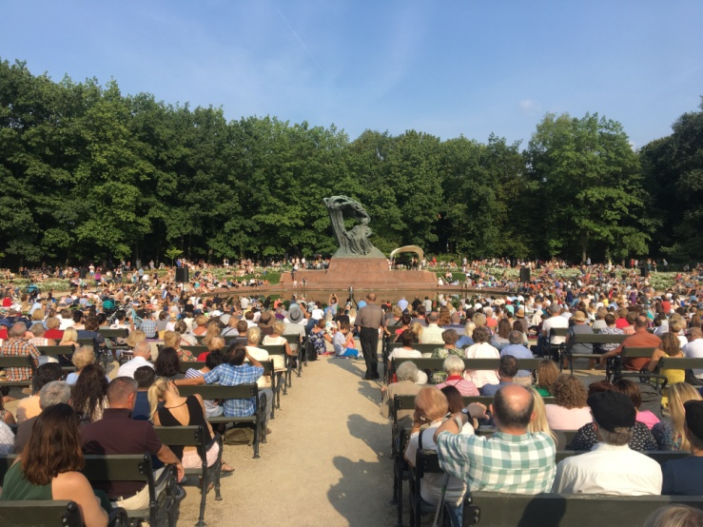
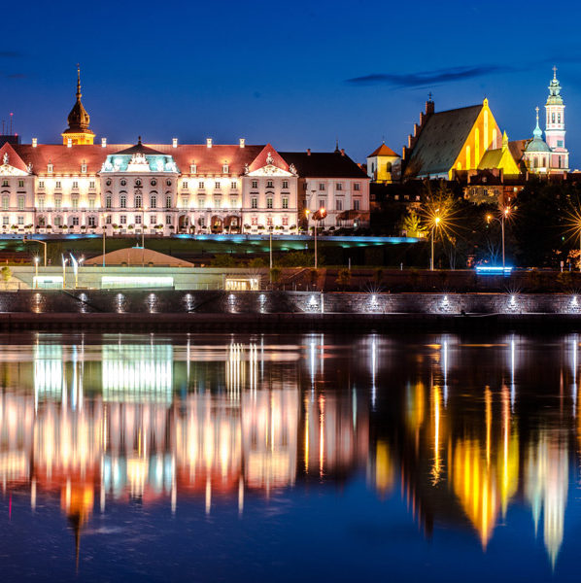
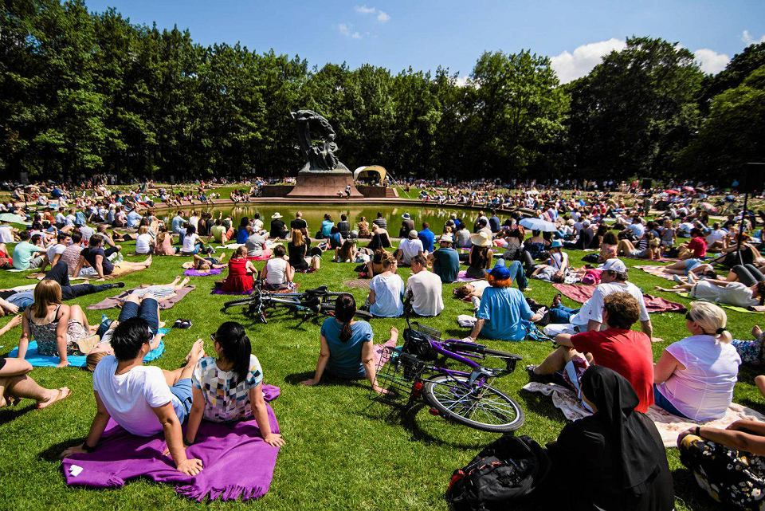
July 13 Saturday: Grunwald Trip – viewing of the largest reconstruction of a medieval battle (over 3.000 knights involved), return to families late evening
July 14 – 15 Sunday – Monday - time with host families, open air Chopin concert

Slide 5
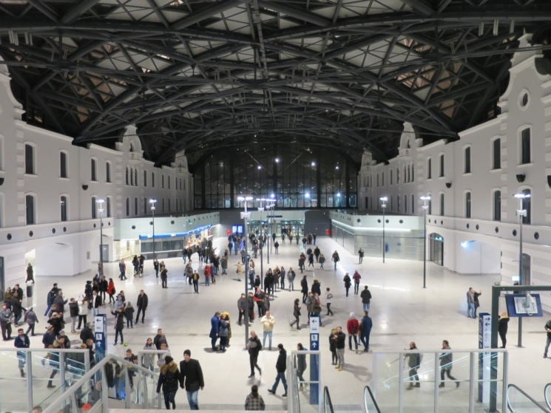
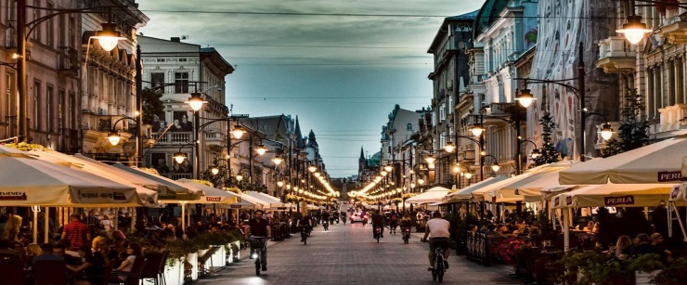
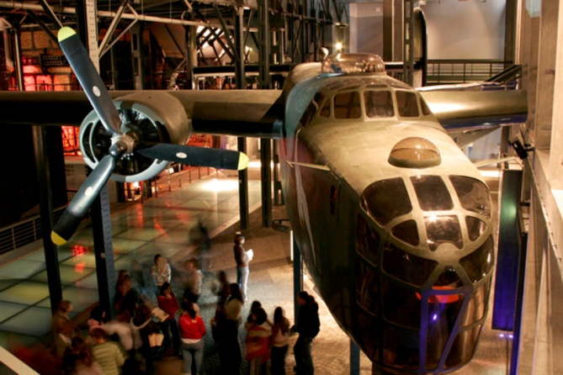
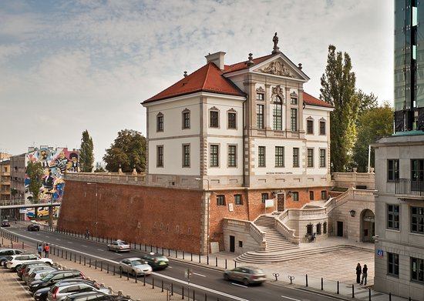
July 16-17 Tuesday – Wednesday Trip to Łódź
July 18 - 20 – Thursday – Saturday - Bowling Tournament (with prizes), Warsaw sightseeing as a group, Uprising Museum, Polin Museum and Chopin Museum visits

Slide 6
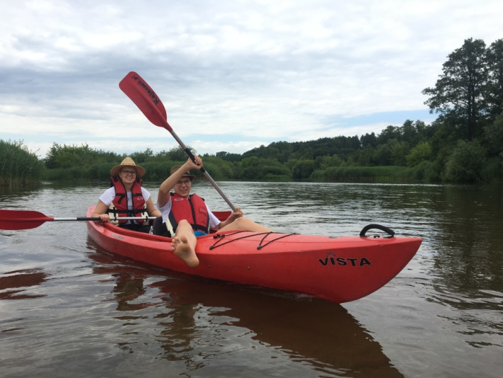
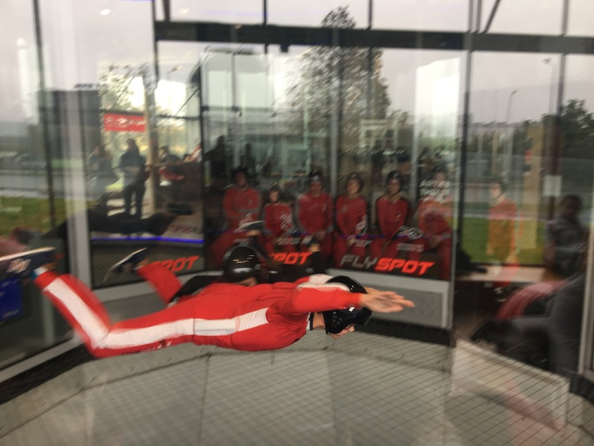
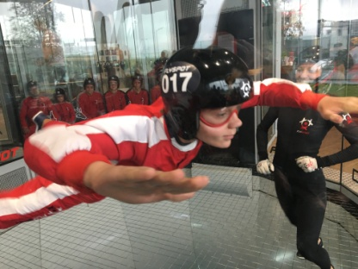
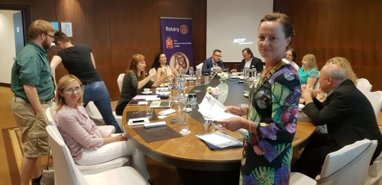
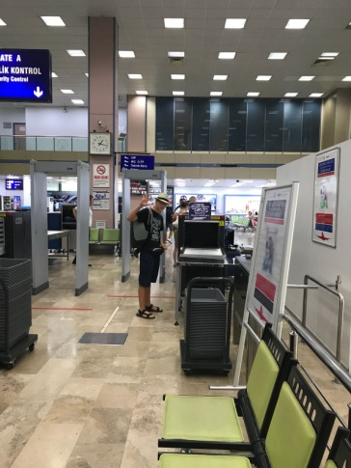
July 21 Sunday – Kayak trip and picnic with host families
July 22 – Monday Flyspot (optional – 60 Eur charge per person for fly spot except winners of bowling tournament) and club meeting
July 23 – Departure from Warsaw Chopin (WAW) or Warsaw Modlin Airports (WMI)

Slide 7
ROTARY CLUB WARSZAWA FRYDERYK CHOPIN YOUTH EXCHANGE OFFICER
1. MICHAŁ SKUP
Mobile :+48695128333 e-mail : michal.skup@eslimaki.pl; m.skup@rotary.org.pl
2. Dorota Komor
Mobile : +48604460987 e-mail : komor@zkw.waw.pl
Thank you for your choosing Poland Past to Present. The camp is organized by Rotary Club Warszawa Fryderyk Chopin.
Our camp coordinator Michał Skup is responsible for all correspondence
Requirements for all participants:
All participants need to be in good physical conditions
All participants should provide health report from medical doctor where a report
issued at most one month before joining the camp.
Please indicate if you are a vegetarian
All participants should covered by international medical, health, accident, travel
etc. insurance
Camp participation fee is 300€(EUR). All participants pay camp participation fee before end of May 2019. You can find bank and payment details on the next page.
Please contact us anytime for any and all questions you may have.
Bank & Payment Details
ACCOUNT OWNER NAME : Rotary Club Warszawa Fryderyk Chopin
IBAN CODE : PL 58 1240 6074 1111 0010 7238 0760
SWIFT CODE : PKOP PL PW LEI: 5493000LKS7B3UTF7H35
ACCOUNT TYPE : PLN
Camp participation fee is 1.300 PLN (ca. 300 EUR).
Please transfer net payment value.
All transaction cost belongs to sender
Please pay before end of May 2019
Please send SWIFT message by email
Camp official language will be English
Alcohol consumption is not allowed
Tobacco consumption is not allowed
Indoor tobacco consumption is not allowed by law.
Any type of drugs consumption or trade is not allowed by law.
Poland’s international calling code is +48
Poland’s electricity voltage is 220V

Slide 8
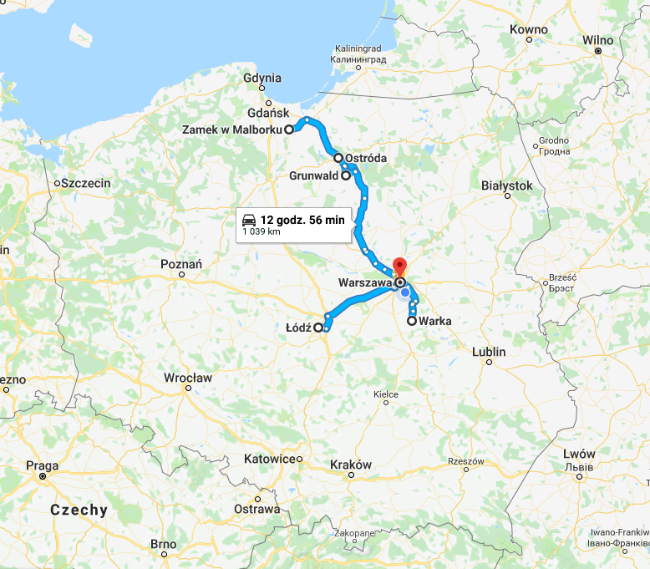
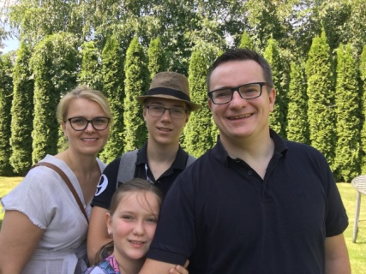
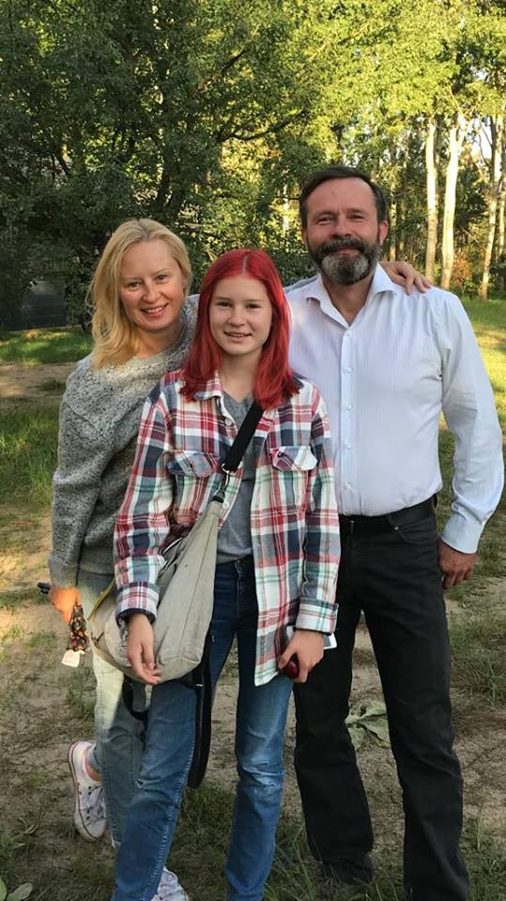
Where we will travel over the 13 days (764 km by coach and car, 3,5 hrs by train)
Who will take care of camp participants?
Camp coordinator & YEO
Rtn. Michał Skup & his family
Camp counsellor & Club President
Rtn. Dorota Komor & her family

